Slide 1
Support Vector Machines
May, 08, 2020

Slide 2
Table of Contents
Support Vector Machine
Max Margin Classifier
Soft Margin Classifier (Support Vector Classifier)
Kernel Methods
Polynomial
RBF

Slide 3
1. Linear Regression

Slide 4


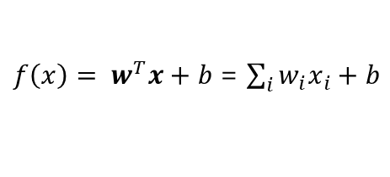
Linear Classifier
x₂ (weight)
Linear Discriminant Function: Hyperplane
w: weight vector
b: bias
Dot Product: inner product / scalar product.
Height | Weight | Gender
160 | 48 | F
164 | 46 | F
168 | 50 | F
172 | 52 | F
175 | 65 | M
178 | 80 | M
183 | 78 | M
192 | 91 | M
90
80
decision boundary
70
$f\left(x\right)= w^{T}x+b$= $\sum_{i}{w_{i}x_{i}}+b$
$$f\left(x\right)= w^{T}x+b<0$$
60
50
w
$$f\left(x\right)= w^{T}x+b>0$$
40
x₁ (height)
160
170
180
190

Slide 5
Linear Classifier
Objective: Choose the best linear model that separates two classes
x₂ (weight)
x₂ (weight)
x₂ (weight)
margin
90
90
90
80
80
80
70
70
margin
70
60
margin
60
60
50
50
50
x₁ (height)
x₁ (height)
x₁ (height)
40
40
40
160
170
180
190
160
170
180
190
160
170
180
190

Slide 6
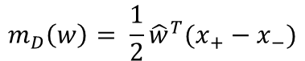
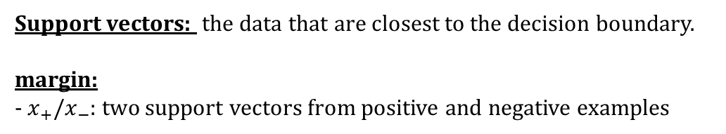
Linear Classifier
Support vectors: the data that are closest to the decision boundary.
margin:
- $x_{+}/x_{−}$: two support vectors from positive and negative examples
x₂ (weight)
90
80
$$m_{D}\left(w\right)= \frac{1}{2}{\hat{w}}^{T}(x_{+}−x_{−})$$
70
margin
60
50
x₁ (height)
40
160
170
180
190

Slide 31
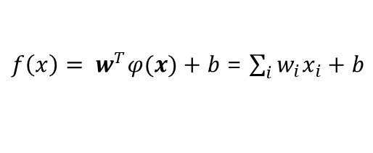
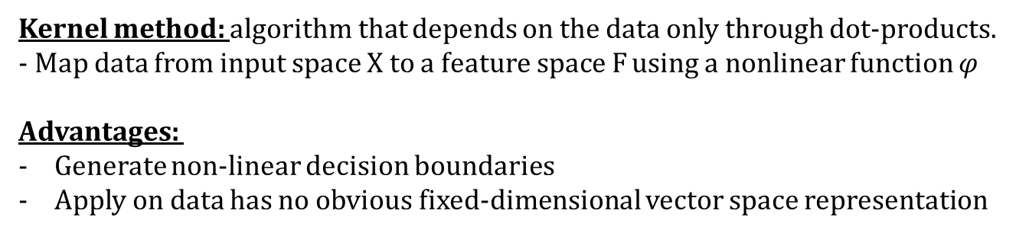
Kernel Methods
Kernel method: algorithm that depends on the data only through dot-products.
- Map data from input space X to a feature space F using a nonlinear function $φ$
Advantages:
Generate non-linear decision boundaries
Apply on data has no obvious fixed-dimensional vector space representation
$f\left(x\right)= w^{T}φ(x)+b$= $\sum_{i}{w_{i}x_{i}}+b$

